Slide 1

Fraud Detection in Online Consumer Reviews
Enhancing Trust and Integrity in E-commerce
Kena Patel, Curtin University (Institute of Data)
Connect with Me:
LinkedIn: linkedin.com/in/kena-patel-85341b23
GitHub: github.com/kena3188/Capston_IOD_Project
Notes:
"Good morning/afternoon, everyone. My name is Kena Patel, and today I’ll be sharing my project on Fraud Detection in Online Consumer Reviews.“
"This project is important because online reviews significantly impact consumer purchasing decisions."

Slide 2
Agenda
Introduction
Outcomes and Implementation
Problem Statements
Modelling
Stakeholders
Data Science Process
Business and Data Questions
Notes:
Here's the agenda for today's presentation. We will start with an overview of the problem of fraudulent reviews and then define the problem statement along with the key stakeholders involved.“
"Next, we’ll discuss the business and data questions we aimed to answer, outline the data science process, explore the modeling phase where we tested various algorithms, present our outcomes and implementation, and conclude with key takeaways."

Slide 3
Introduction
The Role of Online Reviews in Consumer Decision-Making
Crucial for influencing purchasing choices.
Many consumers rely on the experiences of others
Importance of Authenticity in Reviews.
Builds trust between consumers and businesses.
Increases confidence in purchasing decisions.
Growing Issue of Review Fraud Affecting Businesses and Consumers.
Threatens consumer trust and distorts product value.
Can lead to poor purchasing decisions and damage to business reputations.
Employing machine learning techniques to detect and identify fraudulent reviews.
Aiming to empower consumers and help businesses maintain credibility.
Project Focus
Notes:
I’d like to start by discussing the significant role online reviews play in shaping consumer decisions. With so many customers relying on reviews, it’s crucial that they are authentic and trustworthy. However, the rise of fake reviews is becoming a major concern for both consumers and businesses, leading to misinformed decisions and a loss of trust."
"This is where our project comes in. By using advanced machine learning techniques, we aim to detect and combat fraudulent reviews, ensuring a more reliable and transparent online shopping experience. Let me walk you through how this works and the value it brings

Slide 4
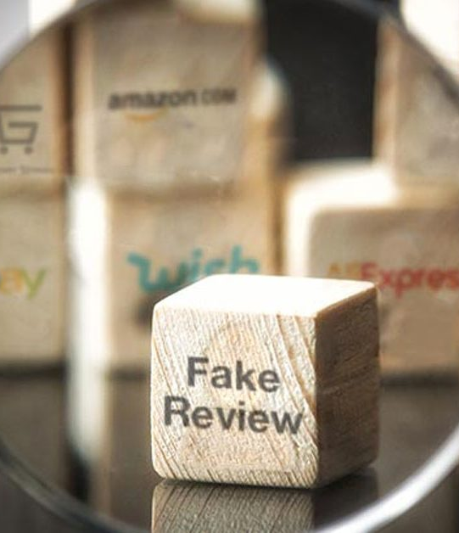
Problem Statements
Loss of Consumer Trust
Revenue Impact
Increased Customer Complaints and Returns
Regulatory Compliance Risks
Review fraud undermines consumer trust and business reputation.
Difficulty in recognizing between genuine and fake reviews.
Lack of effective tools for businesses to monitor and manage reviews.
Notes:
The growing issue of review fraud undermines consumer trust and damages business reputations, leading to poor purchasing decisions and increased complaints. Our project aims to address these challenges by utilizing machine learning techniques to accurately identify and filter out fake reviews, providing reliable information to consumers and helping businesses maintain their credibility
Now that we've addressed the problem statement, let's shift our focus to the stakeholders involved in this issue.

Slide 5
Stakeholders
Consumers rely on authentic reviews for informed purchasing decisions.
E-commerce platforms seek to maintain credibility and trustworthiness among users.
Businesses and brands aim to protect their reputation and prevent losses from fraudulent reviews.
Review platforms require effective systems to monitor and manage review authenticity.
Regulatory authorities focus on ensuring fair practices and consumer protection in online markets.
Data scientists and analysts engage in developing and implementing the fraud detection model.
Notes:
Now that we've addressed the problem statement, let's shift our focus to the stakeholders involved in this issue.
Identifying these key players will help us understand the broader impact of review fraud and how our solution can effectively serve each group.
First, we have consumers. They rely heavily on authentic reviews for informed purchasing decisions. Then, there are e-commerce platforms, which seek to maintain their credibility and trustworthiness among users.
Next, we have businesses and brands. They are focused on protecting their reputation and preventing losses due to fraudulent reviews.
Review platforms also play a critical role, requiring effective systems to monitor and manage review authenticity.
Additionally, regulatory authorities are keen on ensuring fair practices and consumer protection in the online marketplace.
Lastly, let’s not forget about the data scientists and analysts who will be engaged in developing and implementing our fraud detection model.
By recognizing these stakeholders, we can ensure our project addresses their unique concerns and needs.”

Slide 6
Business & Data Questions
What characteristics differentiate genuine reviews from fraudulent ones?
How can machine learning models effectively classify reviews?
What data sources are available for training these models?
How can results be integrated into existing review systems?
Notes:
“Now that we've identified our key stakeholders and their concerns, let's focus on the business and data questions that will shape our project.
First, we need to define our business objectives and determine what metrics or KPIs will measure our success. Next, we'll explore the characteristics that distinguish genuine reviews from fraudulent ones and identify the available data sources, ensuring we maintain data quality.
We will also investigate how machine learning models can effectively classify reviews and how we can integrate our findings into existing systems. Finally, we must consider potential challenges in data collection and analysis, along with strategies to mitigate those risks.
By answering these questions, we align our project with stakeholder needs and build a strong foundation for our fraud detection solution.”

Slide 7
Data Science Process
Data Collection: Gathering labeled review data from platforms like Amazon.
Data Preprocessing: Cleaning and preparing data for analysis.
Feature Engineering: Identifying key features that indicate review authenticity.
Model Selection: Choosing appropriate algorithms (e.g., MNB, SVM, LR, XGB).
Notes:
“Having identified the key business and data questions, we will now focus on the data science process that will guide our project. This process includes collecting labeled review data, preprocessing it for quality, engineering features to identify authenticity, and selecting suitable algorithms like Multinomial Naive Bayes, Support Vector Machine, and Logistic Regression to effectively combat review fraud.”

Slide 8
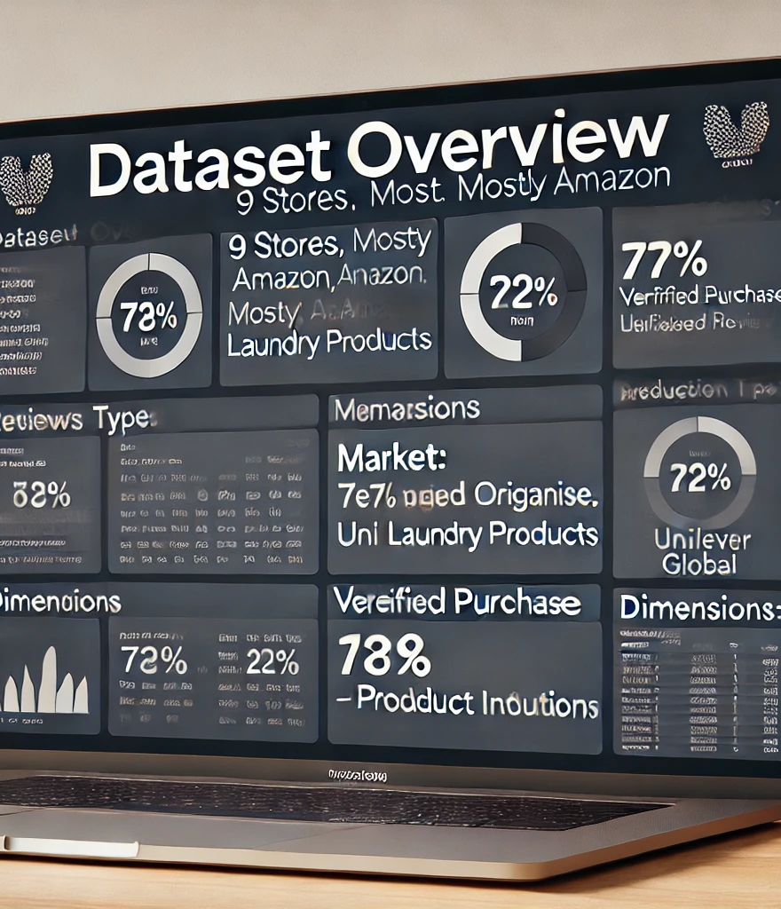
Dataset
Source: 9 stores, primarily Amazon
Category: Personal Care (Laundry products, Comfort brand)
Manufacturer: Unilever Global
Review Types: 77% Organic, 22% Syndicated
Verified Purchase: True/False flag
Market: UK reviews
Dimensions: 1-8 related to additional product details, mostly Laundry.
Notes:
The dataset includes reviews from 9 UK stores, mainly Amazon, focusing on laundry products from Unilever. 77% of the reviews are organic, with common positive feedback like 'good' and 'great value.' Most data is from the Personal Care category, and the dataset covers various product details across eight dimensions. It provides a solid base for analyzing customer sentiment
Now, let's move on to the Exploratory Data Analysis (EDA) phase. This helps us understand the underlying patterns, trends, and insights from the dataset

Slide 9

Exploratory Data Analysis
Notes:
Now, let's move on to the Exploratory Data Analysis (EDA) phase. This helps us understand the underlying patterns, trends, and insights from the dataset

Slide 10
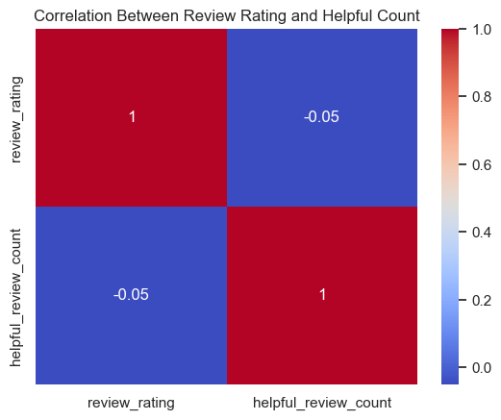
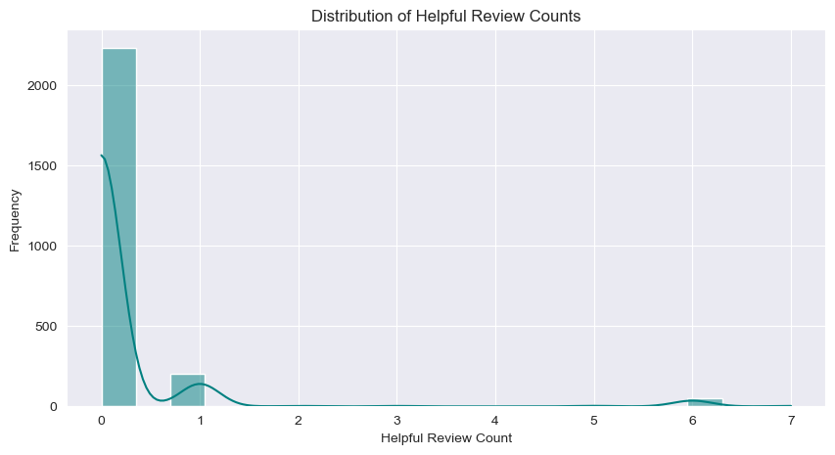
Distribution of Helpful Review Counts
Distribution of Helpful Review Counts:
Most reviews have 0 helpful votes.
Very few reviews have more than 1 helpful vote.
Helpfulness voting is not widely used by customers.
Correlation Between Review Rating and Helpful Count:
Low correlation (-0.05) between review ratings and helpful votes.
High review ratings don’t necessarily mean the review is helpful.
Notes:
Now, let's move on to the Exploratory Data Analysis (EDA) phase. This helps us understand the underlying patterns, trends, and insights from the dataset
"From these charts, we can see that most reviews don’t receive helpful votes. Even when they do, there's almost no relationship between the review rating and how helpful it's considered by other customers. This tells us that helpfulness votes are not playing a major role in influencing purchase decisions based on review quality.“
>We're excluding the helpful_review_count feature because it mostly contains zeros, which won't provide meaningful insights. This decision will help enhance the model's accuracy in identifying genuine reviews

Slide 11
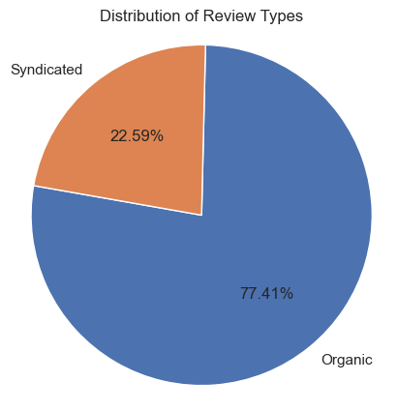
Distribution of Review Types
Organic Reviews:
77.41% of the reviews are organic
Majority of reviews are from direct customers.
Syndicated Review:
22.59% are syndicated, meaning they are sourced from other platforms.
A significant portion of reviews comes from external sources, indicating syndication is a notable factor in reviews.
Notes:
. This pie chart shows that about 77% of the reviews are organic, while 23% are syndicated from other platforms. This indicates that most feedback comes directly from users on this platform, but syndicated reviews still play a considerable role

Slide 12
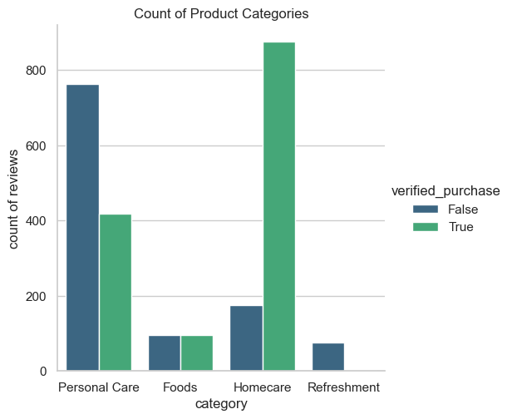
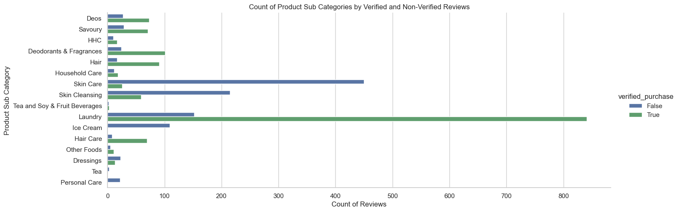
Analysis of Product Categories and Subcategories with Verified Purchases (VP) data
Top Categories:
Homecare and Personal Care have the highest number of reviews.
Verified purchases dominate Homecare reviews.
Subcategory Insights:
Laundry is the most reviewed subcategory, largely from verified purchases.
Skin Care has a higher proportion of non-verified reviews.
Verified vs Non-Verified Trends:
Overall, verified purchases are more frequent, signaling greater reliability.
Notes:
“Here we are looking at the breakdown of product reviews by category and subcategory, highlighting whether they come from verified or non-verified purchases.“
“On the top, you can see Homecare and Personal Care categories have the most reviews, with a significant proportion from verified purchases. This suggests more reliable feedback.“
“Looking at subcategories, Laundry dominates with verified purchases, while Skin Care has a mix but more non-verified reviews. This might hint at promotions or third-party sellers influencing reviews”
These insights can help target the most reliable reviews and understand consumer behaviors across different products

Slide 13
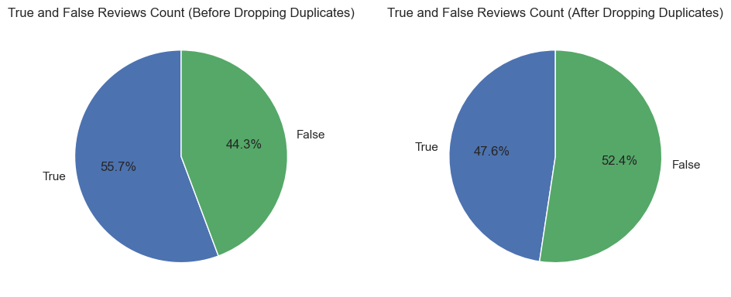
Analyzed reviews based on Verified Purchases (VP) data
Initial Review Distribution:
56% True reviews (from verified purchases)
44% False reviews (from non-verified purchases)
Majority of reviews come from actual purchasers, but a notable percentage are from non-purchasers.
Impact of Amazon's Verified Purchase System:
Helps reduce fake reviews by allowing only genuine purchasers to leave feedback.
Increases trust in the review system
Post-Duplicate Review Analysis:
After removing duplicates, True reviews dropped to 47%
False reviews increased to 52%, indicating a slight shift.
Dataset remains relatively balanced between true and false review
Notes:
We analyzed the Verified Purchases (VP) data, which tells us whether a review is from a customer who actually bought the product. Initially, the reviews were split between 56% true (from verified purchases) and 44% false (from non-verified purchases). This means that most reviews were from people who had purchased the product, but there was still a significant amount from those who hadn’t.
Amazon's Verified Purchase system helps reduce fake reviews by only allowing reviews from people who have made a purchase, giving more trust to the feedback.
After removing duplicate reviews, we found that True reviews dropped to 47% and False reviews increased slightly to 52%. This shows a small shift in the balance but overall, the dataset remains well-balanced between true and false reviews."

Slide 14
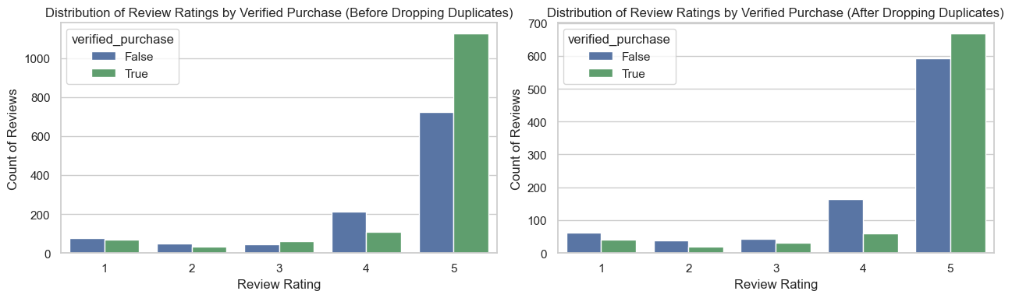
Analyzed reviews Ratings by Verified Purchases (VP) data
Impact of Removing Duplicates:
Significant drop in total review counts.
Distribution Consistency:
Proportion of true (verified purchases) and false reviews remains nearly unchanged.
5-Star Rating Dominance:
Majority of reviews still exhibit high ratings, indicating that duplicates do not inflate ratings.
Integrity of Ratings:
The overall integrity of the ratings distribution is preserved.
Fraudulent activity, if present, is evenly distributed across all ratings.
Notes:
After removing duplicate reviews, we found a significant decrease in total reviews, but the ratio of true to false reviews remained stable. The majority still have 5-star ratings, indicating that these ratings are not artificially inflated by duplicates. This confirms the integrity of the ratings distribution, with any fraudulent activity spread evenly across all ratings

Slide 15
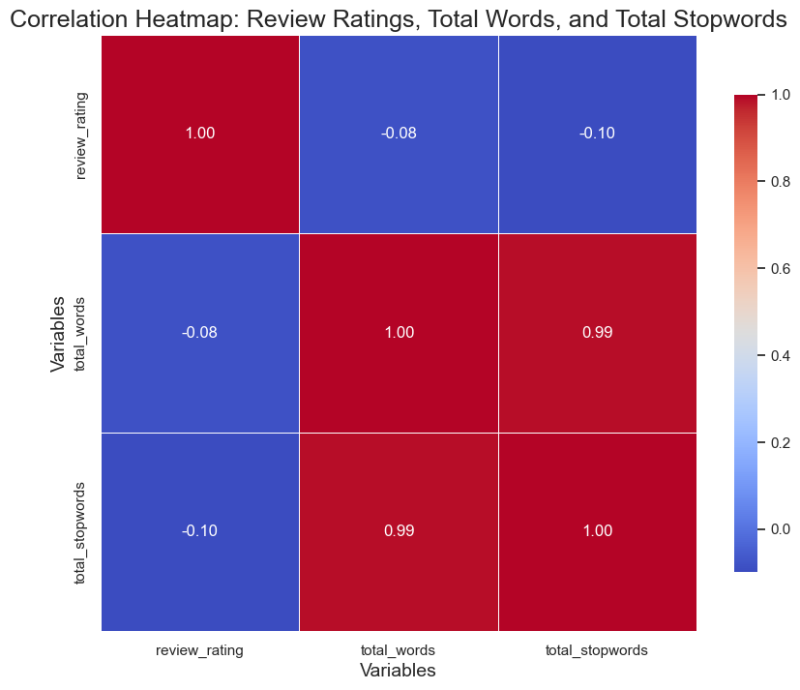
Correlation for Review Analysis
Variables Overview:
Review Ratings: Indicator of customer satisfaction.
Total Words: Total number of words in each review.
Total Stop words: Count of common, less significant words.
Heatmap Purpose:
Displays the strength and direction of relationships between variables.
Key Findings:
Strong Correlation (0.99)
Total Words ↔ Total Stopwords
“Longer reviews tend to include more common words”
Weak Correlation (-0.08):
Review Ratings ↔ Total Words
"Review length has little effect on the ratings.“
Implications
Understanding these relationships helps in analyzing customer feedback effectively.
Notes:
Variables: We’re looking at Review Ratings, Total Words, and Total Stopwords.
Key Findings:
There’s a strong correlation (0.99) between Total Words and Total Stopwords, meaning longer reviews tend to have more common words.
There’s a weak correlation (-0.08) between Review Ratings and Total Words, indicating that the length of a review doesn’t really affect its rating.
These insights help us understand the relationship between review content and ratings better, guiding our analysis moving forward.”

Slide 16
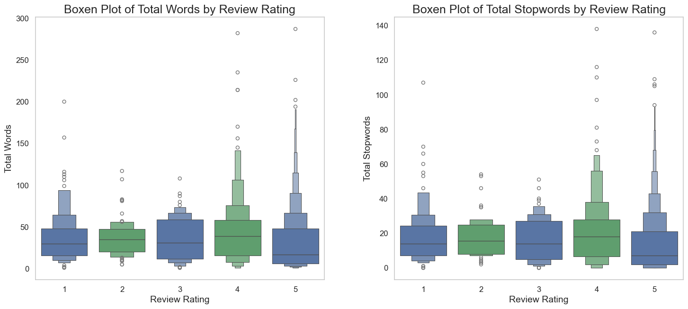
Analyzed reviews Ratings by Verified Purchases (VP) data
Impact of Removing Duplicates:
Significant drop in total review counts.
Distribution Consistency:
Proportion of true (verified purchases) and false reviews remains nearly unchanged.
5-Star Rating Dominance:
Majority of reviews still exhibit high ratings, indicating that duplicates do not inflate ratings.
Integrity of Ratings:
The overall integrity of the ratings distribution is preserved.
Fraudulent activity, if present, is evenly distributed across all ratings.

Slide 17
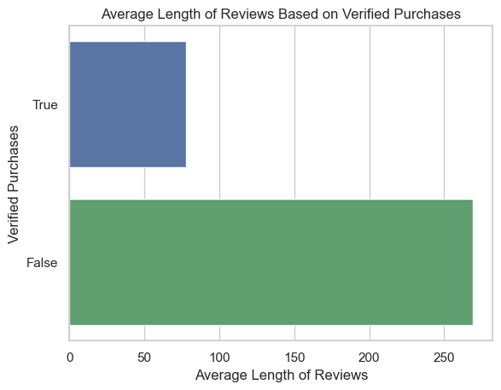
Analyzed Length of Reviews on Verified Purchases (VP)
False Reviews:
Average Length: >250 characters
Verified Reviews:
Average Length: 50-100 characters
Insight:
Longer reviews may indicate inauthenticity.
Conclusion:
Length can signal review authenticity.
Notes:
The graph shows that false reviews (unverified purchases) are, on average, much longer than verified reviews, with false reviews exceeding 250 characters compared to the 50 to 100 characters typical of verified ones. This aligns with insights from fraud detection platforms, indicating that longer reviews may be an attempt to seem more detailed or convincing, despite lacking genuine product experience.

Slide 18
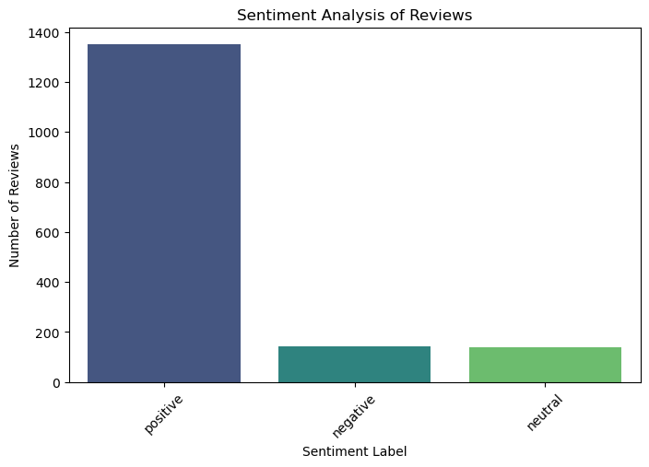
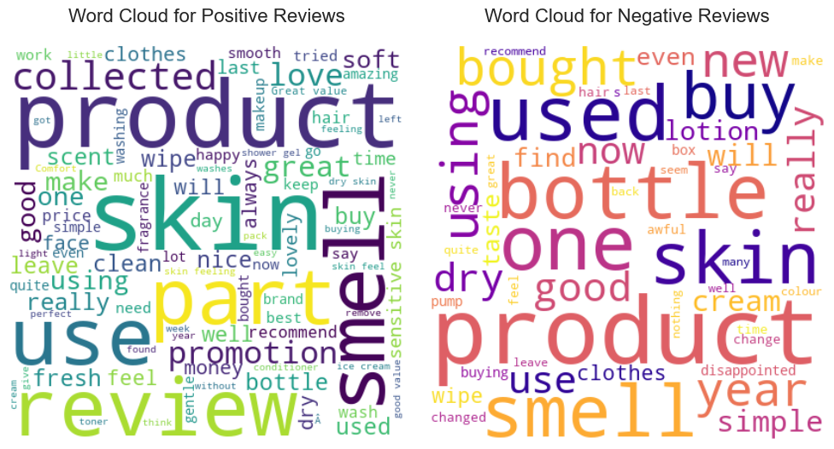
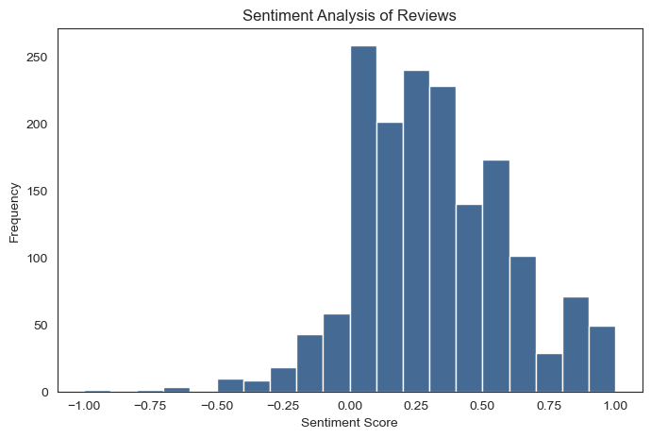
Sentiment Analysis of Reviews
The number of reviews categorized by sentiment—positive, negative, and neutral
Positive Reviews Word Cloud:
Highlight the big words like “smell,” “skin,” “part,” and “soft.” These are the words people use most when they say good things
Negative Reviews Word Cloud:
Show words like “bottle,” “one,” “buy,” and “disappointed.” These are the frequent words when people are unhappy.
X-Axis (Sentiment Score):
Ranges from -1.0 to 1.0 in increments of 0.25.
Scores close to -1 are highly negative, 0 is neutral, and scores close to 1 are highly positive.
Y-Axis (Frequency):
Shows how many reviews fall within each sentiment score range, ranging from 0 to 250.
Notes:
Overview: “This bar chart shows the number of reviews categorized by sentiment—positive, negative, and neutral.”
Main Point: “As you can see, the majority of reviews are positive, close to 1,400. This indicates strong customer satisfaction.”
Negative and Neutral: “Negative and neutral reviews are significantly fewer, each below 200. This highlights areas with some customer concerns but also shows they're not a major issue overall.”
Conclusion: “Overall, the high number of positive reviews is a great indicator of customer happiness, with only a small percentage of reviews indicating dissatisfaction.”
Positive Reviews:
"On the left, we see the words that customers commonly use in positive reviews, like 'smell,' 'skin,' 'part,' and 'soft.' These highlight the features they love about the product, especially its pleasant scent and texture."
Negative Reviews:
"On the right, we have the words from negative reviews, such as 'bottle,' 'one,' 'buy,' and 'disappointed.' This indicates common issues customers face, particularly related to the packaging or their overall experience."
Summary:
"The positive word cloud shows what customers appreciate, while the negative cloud points out areas needing improvement. Understanding these sentiments helps us enhance the product and better meet customer expectations.

Slide 19

Machine Learning Models
Notes:
Now, let's move on to the Modeling phase.
1. Introduction to the Models and Vectorizers
In this analysis, several machine learning models like Random Forest, Gradient Boosting, and Support Vector Machines (SVM) were used. These models were trained on text data that was transformed into numerical data using different vectorization techniques like TF-IDF, Count Vectorizer, and N-gram. These techniques help convert the text into numbers so the models can classify the data
2. Metrics Breakdown
We evaluated each model using different performance metrics. Accuracy tells us how often the model makes correct predictions. Precision tells us how many of the predicted positives were actually correct. Recall shows how many of the actual positives were correctly identified, and F1 Score balances both precision and recall.“
3. Interpreting Accuracy
Looking at the table, we can see that Support Vector Machine (SVM) has the highest accuracy of 81.69% using the Character Level Vectorizer. This means it correctly predicted the label in about 82% of the cases. Logistic Regression (LR) and Random Forest Classifier (RFC) also performed well across different vectorizers, especially the Count Vectorizer and Hashing Vectorizer.“
4. Precision and Recall Trade-off
SVM has a high precision score of 80.33% with the Hashing Vectorizer, meaning when it predicted a positive class, it was correct 80% of the time. However, its recall is slightly higher with the N-gram Vectorizer at 95.09%, meaning it was very good at identifying actual positives. There's often a trade-off between precision and recall. For instance, Naive Bayes (MNB) achieved very high precision with TF-IDF but lower recall, indicating it's more conservative in predicting positives
5. F1 Score: The Balance
F1 Score combines both precision and recall into a single metric, which is important when we need a balance between these two. For example, Random Forest (RFC) performs well in terms of F1 Score across different vectorizers, especially with 85.96% using TF-IDF. This shows that it's not only good at identifying positives but also maintaining a good balance between precision and recall.“
6. Impact of Vectorizers
The choice of vectorizer also impacts model performance. For instance, GBC performs similarly across all vectorizers, but models like SVM show significant improvements with the TF-IDF vectorizer, especially in terms of accuracy and recall. This indicates that some models respond better to certain representations of the text data.“
7. Conclusion and Recommendation
In conclusion, while all models have their strengths, Support Vector Machine (SVM) and Random Forest (RFC) consistently performed well across different vectorizers, especially with TF-IDF and N-gram. For future projects, using a combination of these models and vectorizers could yield better results depending on the specific goals of the analysis."

Slide 20
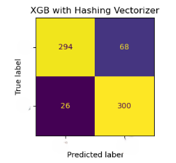
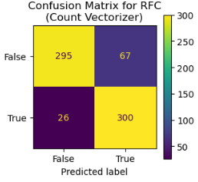
Comparing Machine Learning Models
 | Accuracy (%) |  |  |  |  | Precision (%) |  |  |  |  | Recall (%) |  |  |  |  | F1 Score (%)
Model | Character Level Vectorizer | Count Vectorizer | Hashing Vectorizer | N-gram Vectorizer | TF-IDF Vectorizer | Character Level Vectorizer | Count Vectorizer | Hashing Vectorizer | N-gram Vectorizer | TF-IDF Vectorizer | Character Level Vectorizer | Count Vectorizer | Hashing Vectorizer | N-gram Vectorizer | TF-IDF Vectorizer | Character Level Vectorizer | Count Vectorizer | Hashing Vectorizer | N-gram Vectorizer | TF-IDF Vectorizer
GBC | 79.94 | 84.45 | 83.87 | 83.43 | 83.43 | 79.56 | 78.15 | 78.07 | 76.63 | 77.75 | 77.61 | 93.25 | 91.72 | 93.56 | 91.10 | 78.57 | 85.03 | 84.34 | 84.25 | 83.90
LR | 79.22 | 80.67 | 79.36 | 78.49 | 79.51 | 73.28 | 78.47 | 78.93 | 70.51 | 79.94 | 88.34 | 81.60 | 76.99 | 93.87 | 75.77 | 80.11 | 80.00 | 77.95 | 80.53 | 77.80
MNB | 56.54 | 79.80 | 72.09 | 76.74 | 80.38 | 55.34 | 82.81 | 87.64 | 79.23 | 82.59 | 42.94 | 72.39 | 47.85 | 69.02 | 74.23 | 48.36 | 77.25 | 61.90 | 73.77 | 78.19
RFC | 79.94 | 86.48 | 86.19 | 83.58 | 86.19 | 79.94 | 81.74 | 81.30 | 76.43 | 81.47 | 76.99 | 92.02 | 92.02 | 94.48 | 91.72 | 78.44 | 86.58 | 86.33 | 84.50 | 86.29
SVM | 81.98 | 82.27 | 79.22 | 69.48 | 80.38 | 79.53 | 78.02 | 81.02 | 61.07 | 83.99 | 83.44 | 87.12 | 73.31 | 98.16 | 72.39 | 81.44 | 82.32 | 76.97 | 75.29 | 77.76
XGB | 78.20 | 84.01 | 84.45 | 85.76 | 85.03 | 76.51 | 80.51 | 82.30 | 81.84 | 81.59 | 77.91 | 87.42 | 85.58 | 89.88 | 88.34 | 77.20 | 83.82 | 83.91 | 85.67 | 84.83
Notes:
Here I tested multiple models to accurately detect fraudulent reviews, improving customer trust in the feedback system
To identify fraudulent reviews with high accuracy while minimizing false positives.
I explored various machine learning models, such as Random Forest, Support Vector Machine, and XGBoost, using different methods to vectorize the text data (e.g., Count Vectorizer, TF-IDF, N-gram).
Random Forest Classifier (RFC) with Count Vectorizer is the top-performing model with an accuracy of 86.48% and recall of 92.02%, making it the best option for detecting fraud while maintaining a low number of missed fraudulent reviews.
Accuracy: 86.48%Precision: 81.74%
Recall: 92.02%F1 Score: 86.58%
True Negatives (TN): 295 — Reviews correctly predicted as not fraudulent.
False Positives (FP): 67 — Reviews incorrectly flagged as fraudulent.
False Negatives (FN): 26 — Fraudulent reviews missed by the model.
True Positives (TP): 300 — Fraudulent reviews correctly identified.
Multinomial Naive Bayes (MNB) with Hashing Vectorizer is highly precise but less effective in detecting all fraudulent reviews, with a recall of 47.85%.
Accuracy: 72.09%Precision: 87.64%
Recall: 47.85%F1 Score: 61.90%
True Negatives (TN): 340
False Positives (FP): 22
False Negatives (FN): 170
True Positives (TP): 156
Support Vector Machine (SVM) with N-gram Vectorizer detects almost all fraudulent reviews with a recall of 98.16%, but the high number of false positives (204) could result in unnecessary manual reviews.
Accuracy: 69.48%
Precision: 61.07%
Recall: 98.16%
F1 Score: 75.29%
True Negatives (TN): 158
False Positives (FP): 204
False Negatives (FN): 6
True Positives (TP): 320

Slide 21
Comparing Machine Learning Models
 | Model | Vectorizer | Accuracy (%) | Precision (%) | Recall (%) | F1 Score (%) | TN | FP | FN | TP
15 | RFC | Hashing Vectorizer | 0.86 | 0.82 | 0.91 | 0.86 | 295 | 67 | 29 | 297
23 | XGB | N-gram Vectorizer | 0.86 | 0.82 | 0.90 | 0.86 | 297 | 65 | 33 | 293
3 | RFC | Count Vectorizer | 0.86 | 0.81 | 0.91 | 0.86 | 291 | 71 | 28 | 298
11 | XGB | TF-IDF Vectorizer | 0.85 | 0.82 | 0.88 | 0.85 | 297 | 65 | 38 | 288
9 | RFC | TF-IDF Vectorizer | 0.85 | 0.80 | 0.91 | 0.85 | 286 | 76 | 28 | 298
 | Model | Vectorizer | Accuracy (%) | Precision (%) | Recall (%) | F1 Score (%) | TN | FP | FN | TP
47 | XGB | Hashing Vectorizer | 0.86 | 0.87 | 0.86 | 0.86 | 294 | 68 | 26 | 300
17 | XGB | Hashing Vectorizer | 0.86 | 0.87 | 0.86 | 0.86 | 294 | 68 | 26 | 300
9 | RFC | TF-IDF Vectorizer | 0.86 | 0.86 | 0.86 | 0.86 | 289 | 73 | 26 | 300
45 | RFC | Hashing Vectorizer | 0.85 | 0.86 | 0.85 | 0.85 | 288 | 74 | 26 | 300
39 | RFC | TF-IDF Vectorizer | 0.85 | 0.86 | 0.85 | 0.85 | 287 | 75 | 26 | 300
Notes:
Here I tested multiple models to accurately detect fraudulent reviews, improving customer trust in the feedback system
To identify fraudulent reviews with high accuracy while minimizing false positives.
I explored various machine learning models, such as Random Forest, Support Vector Machine, and XGBoost, using different methods to vectorize the text data (e.g., Count Vectorizer, TF-IDF, N-gram).
Random Forest Classifier (RFC) with Count Vectorizer is the top-performing model with an accuracy of 86.48% and recall of 92.02%, making it the best option for detecting fraud while maintaining a low number of missed fraudulent reviews.
Accuracy: 86.48%Precision: 81.74%
Recall: 92.02%F1 Score: 86.58%
True Negatives (TN): 295 — Reviews correctly predicted as not fraudulent.
False Positives (FP): 67 — Reviews incorrectly flagged as fraudulent.
False Negatives (FN): 26 — Fraudulent reviews missed by the model.
True Positives (TP): 300 — Fraudulent reviews correctly identified.
Multinomial Naive Bayes (MNB) with Hashing Vectorizer is highly precise but less effective in detecting all fraudulent reviews, with a recall of 47.85%.
Accuracy: 72.09%Precision: 87.64%
Recall: 47.85%F1 Score: 61.90%
True Negatives (TN): 340
False Positives (FP): 22
False Negatives (FN): 170
True Positives (TP): 156
Support Vector Machine (SVM) with N-gram Vectorizer detects almost all fraudulent reviews with a recall of 98.16%, but the high number of false positives (204) could result in unnecessary manual reviews.
Accuracy: 69.48%
Precision: 61.07%
Recall: 98.16%
F1 Score: 75.29%
True Negatives (TN): 158
False Positives (FP): 204
False Negatives (FN): 6
True Positives (TP): 320

Slide 22
Comparing Machine Learning Models
Classification Model
Text Vectorizers
Count Vectorizer
TF-IDF Vectorizer
Hashing Vectorizer
N-gram Vectorizer
Character Level Vectorizer
MULTINOMIAL NAIVE BAYES,
SVM,
LOGISTIC REGRESSION,
RANDOM FOREST,
GRADIENT BOOSTING,
XGBOOST
Notes:
Here I tested multiple models to accurately detect fraudulent reviews, thereby enhancing customer trust in the feedback system. The goal was to identify fraudulent reviews with high accuracy while minimizing false positives
I explored various machine learning models, such as Random Forest, Support Vector Machine, and XGBoost, using different methods to vectorize the text data (e.g., Count Vectorizer, TF-IDF, N-gram).
Methodology
Machine Learning Models: We explored several machine learning algorithms that are well-suited for classification tasks:
Random Forest: An ensemble method that combines multiple decision trees to improve accuracy and reduce overfitting.
Support Vector Machine (SVM): A powerful model that finds the optimal hyperplane to separate classes in high-dimensional spaces.
XGBoost: An advanced boosting algorithm known for its performance and efficiency, especially in handling large datasets.
Text Vectorization Methods: To effectively analyze the text data from reviews, we employed different vectorization techniques:
Count Vectorizer: Converts text documents into a matrix of token counts, allowing us to see the frequency of each word.
TF-IDF (Term Frequency-Inverse Document Frequency): This method weights the importance of words based on their frequency across all documents, helping to highlight more informative words.
N-gram Vectorization: Captures sequences of words (bigrams, trigrams) to understand context better, which is crucial for detecting fraudulent patterns.
Results
Performance Metrics: Each model's performance was evaluated based on key metrics:
Accuracy: The overall correctness of the model.
Precision: The proportion of true positive results in the predictions, important to minimize false positives.
Recall: The ability of the model to identify all relevant cases of fraud.
F1 Score: A balance between precision and recall, giving us a single metric to assess the model’s performance.
Comparison: After evaluating various combinations of models and vectorizers, we identified the best-performing model that not only achieved high accuracy but also minimized the risk of misclassifying legitimate reviews as fraudulent.
Conclusion
Customer Trust: By implementing these models and techniques, we aim to significantly improve the accuracy of our fraud detection system. This will enhance the credibility of customer feedback and ultimately build stronger trust in our platform.
Next Steps: We recommend ongoing monitoring and fine-tuning of the model, along with a periodic review of the text vectorization methods, to adapt to new trends in fraudulent behavior.

Slide 23
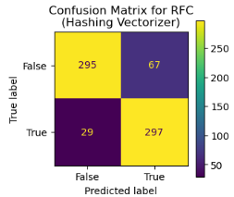
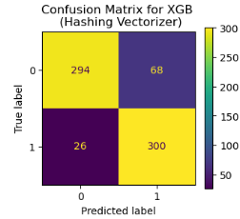
Best Machine Learning Models
Metric | Value
Model | Random Forest Classifier (RFC)(without hyperparameters)
Vectorizer | Hashing Vectorizer
Accuracy (%) | 0.86
Precision (%) | 0.82
Recall (%) | 0.91
F1 Score (%) | 0.86
True Negatives (TN) | 295
False Positives (FP) | 67
False Negatives (FN) | 29
True Positives (TP) | 297
Metric | Value
Model | XGBoost (XGB)(with hyperparameters)
Vectorizer | Hashing Vectorizer
Accuracy (%) | 0.86
Precision (%) | 0.87
Recall (%) | 0.86
F1 Score (%) | 0.86
True Negatives (TN) | 294
False Positives (FP) | 68
False Negatives (FN) | 26
True Positives (TP) | 300
Best Parameters | {'classifier__n_estimators': 100, 'classifier__max_depth': 5, 'classifier__learning_rate': 0.1}
Notes:
The Random Forest Classifier, with an accuracy of 0.86%, is effective in identifying fraudulent reviews without the need for hyperparameter tuning. Its high recall rate of 0.91% indicates that the model is particularly good at detecting true positive cases (genuine fraudulent reviews), while the precision rate of 0.80% shows a balanced performance in minimizing false positives. The overall performance metrics, including the F1 Score of 0.86%, demonstrate the model's reliability in the classification task.
The XGBoost model, optimized with hyperparameters, provides a robust accuracy of 0.86%, demonstrating its efficacy in distinguishing between fraudulent and genuine reviews. The model's precision and recall values further validate its effectiveness, indicating a balanced performance in identifying positive cases.
If minimizing false positives is a priority (high precision is important), the XGBoost model is the better choice due to its higher precision and accuracy.
If maximizing recall is crucial (detecting as many fraud cases as possible), then the Random Forest Classifier is superior because of its significantly higher recall.
In short the best model depends on the specific objectives of our project—whether you prioritize recall, precision, or overall accuracy.
If our aim for a balanced approach, the XGBoost model with hyperparameters may be preferred due to its overall stronger metrics.

Slide 24
Outcomes and Implementation
Outcomes
Best Model:
XGBoost: 0.86% accuracy(with hyperparameters)
Model Performances:
Precision: 0.87%
Feature Importance:
Word frequency, sentiment scores, review length
Validation:
Cross-validation ensures robustness
Deployment Ready:
Integrable with existing systems
Recall: 0.86%
F1Score: 0.86%
56% True reviews (from verified purchases)
44% False reviews (from non-verified purchases)
Longer reviews may indicate inauthenticity.
Implementation
User-Friendly Dashboard:
Visualizes detection results in real-time
Intuitive interface for easy navigation
Features real-time alerts for suspicious review activities..
API Integration:
Seamless integration with existing review management systems.
Facilitates automated fraud detection and reporting.
Supports multiple data formats for flexibility.
Training and Support:
Comprehensive training sessions for staff.
User manuals and documentation provided.
Ongoing technical support available
Regular updates to enhance functionality
Notes:
Successful Implementation: Developed and validated a fraud detection model leveraging machine learning techniques, with XGBoost identified as the best-performing model.
Performance Metrics:
Accuracy: 0.86%
Precision: 0.86%
Recall: 0.86%
F1 Score: 0.86%
These metrics indicate a well-balanced performance in identifying fraudulent reviews.
Data Insights
Review Authenticity:
56% of reviews are verified as true (from verified purchases).
44% are potentially false, highlighting significant fraudulent activity in the dataset.
Length Analysis: Reviews exceeding 250 characters are frequently linked to inauthenticity, revealing a pattern that can inform future model enhancements.
Sentiment Analysis
Sentiment Categorization: Reviews were classified into positive, negative, and neutral sentiments, offering valuable insights into consumer opinions.
Customer Satisfaction: Utilized sentiment scores to assess overall customer satisfaction and review quality

Slide 25
THANK YOU

